Slide 1

Covid - 19 Analysis Using Power BI and ArcGIS
Team 7
Rohan Parkar
Pinaki Babar

Slide 2
Table of contents
01
Introduction
02
Data Collection and Preprocessing
03
Interactive Dashboards Using Power BI
04
Spatial Mapping Using ArcGIS

Slide 3
Table of contents
05
Trend Analysis
06
Conclusion
07
References

Slide 4
—Clive Humby
“Data is the new oil. It’s valuable, but if unrefined, it cannot really be used.”

Slide 5
Introduction
01

Slide 6
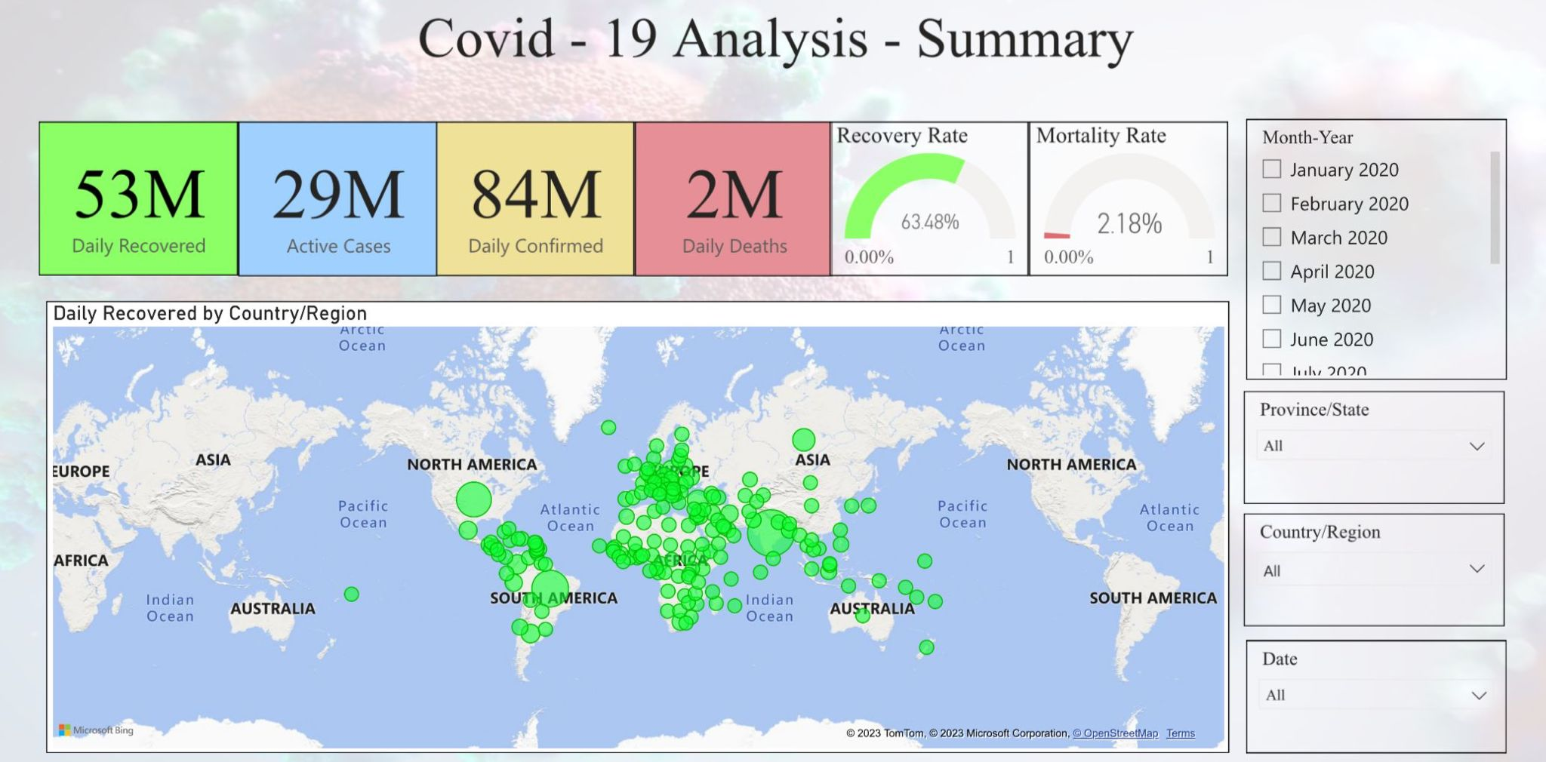

Slide 7
The COVID-19 pandemic has had a significant global impact, affecting health, the economy, and communities worldwide.
Understanding the patterns and trends of the virus is crucial for making informed decisions and allocating resources effectively.
Power BI and ArcGIS are powerful tools for data visualization and geospatial analysis that can be used to analyze COVID-19 data in-depth.

Slide 8
Data Collection and Preprocessing
02

Slide 9
COVID-19 data was collected from reliable sources such as GitHub, the World Health Organisation (WHO), and national health organizations.
Data cleaning, normalization, and consolidation were performed to ensure data accuracy and consistency.

Slide 10
Interactive Dashboards Using Power BI
03

Slide 11
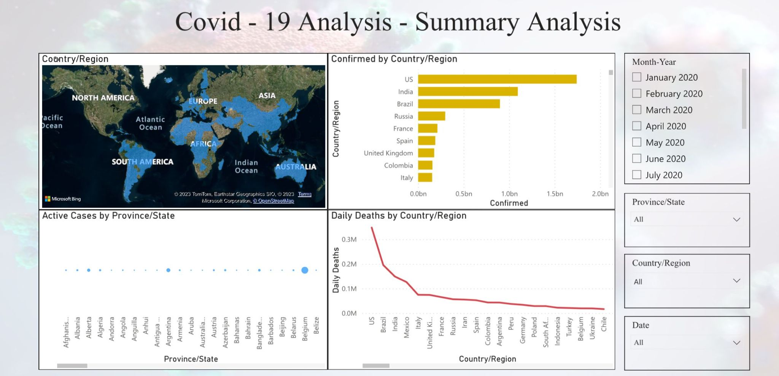

Slide 12
Power BI offers a user-friendly and interactive interface for designing dynamic dashboards.
Interactive charts, tables, and filters were utilized to allow users to explore COVID-19 data at different granularities.
Example: Basic summary analysis of COVID-19 data, including active cases, confirmed cases, and daily deaths, using Power BI.

Slide 13
Spatial Mapping Using ArcGIS
04

Slide 14
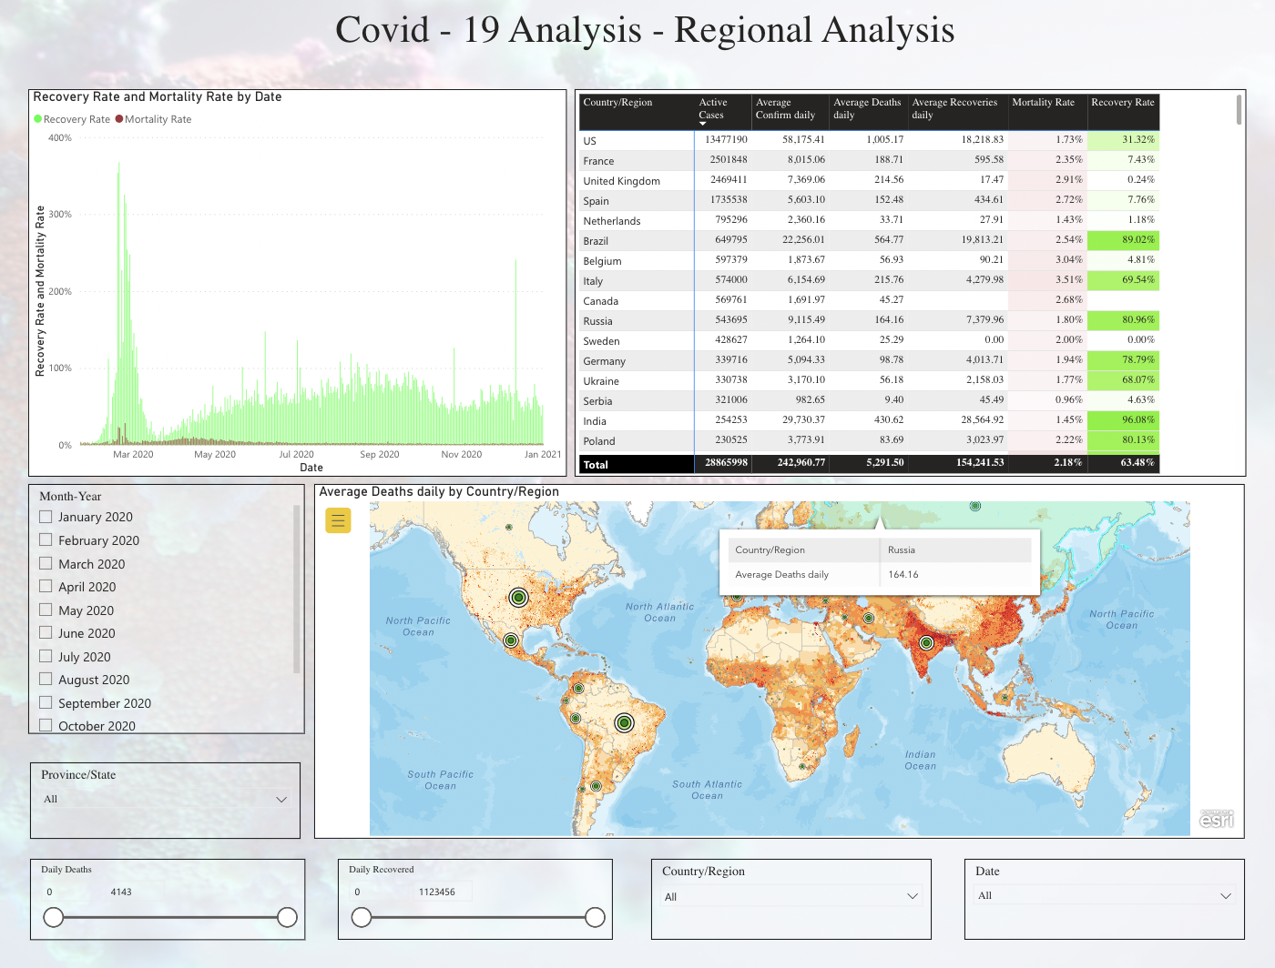

Slide 15
ArcGIS was used to visualize and analyze COVID-19 data on maps.
Spatial mapping allowed the representation of COVID-19 data by location and demonstrated the variation in average daily death count.
Population density was added as a second layer to assess its impact on the spread of the virus.

Slide 16
Trend Analysis
05

Slide 17
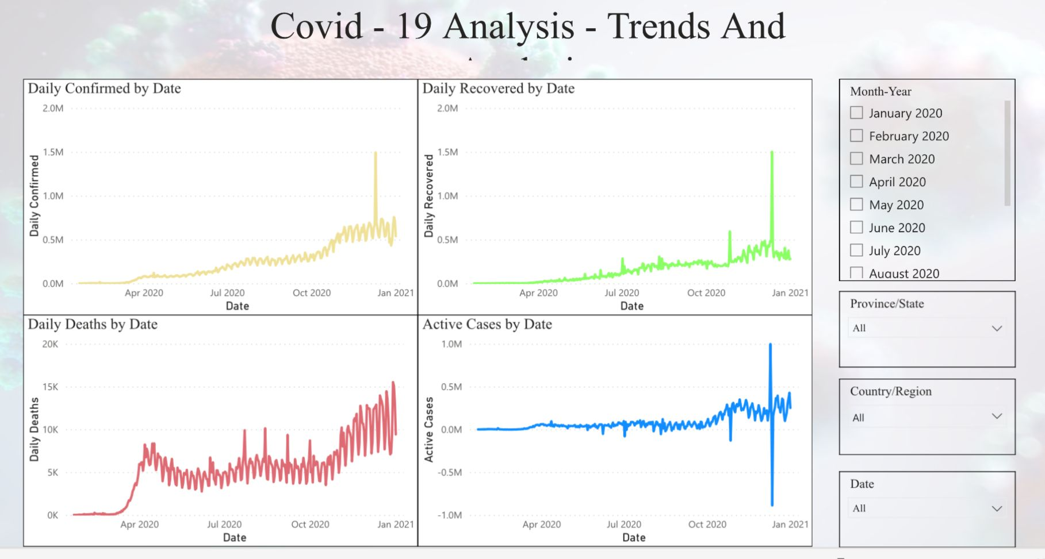

Slide 18
Trend analysis is essential for understanding how the pandemic has changed over time.
Dynamic time series visualizations in Power BI were employed to examine COVID-19's development over time.
Trends in cases, fatalities, and recoveries were visualized to identify peak times, fluctuations, and broad trajectories of the virus.

Slide 19
Conclusion
06

Slide 20
The combined use of Power BI and ArcGIS provides a comprehensive and dynamic method for analyzing COVID-19 data.
Data-driven decisions, efficient resource allocation, and targeted interventions can be made by policymakers, healthcare workers, and academics.
Geographical analysis and data visualization are crucial in comprehending and controlling the COVID-19 pandemic.

Slide 21
References
05

Slide 22
[1] S. Graves and L. He, “Covid-19 Mapping with Microsoft Power BI,” Terra Digitalis, Oct. 2020, doi: 10.22201/igg.25940694e.2020.2.74.
[2] R. Ahasan, Md. S. Alam, T. Chakraborty, and Md. M. Hossain “Applications of GIS and geospatial analyses in COVID-19 research: A systematic review,” F1000Res, vol. 9, p. 1379, Jan. 2022, doi:10.12688/f1000research.27544.2.
[3] ”COVID CoronaVirus Statistics Worldometer” https://www.worldometers.info/coronavirus/ (accessed Jun. 24, 2023)

Slide 23
[4] https://covid19.who.int/data (Accessed Jun. 24, 2023).
[5]“GitHub-Rohanvp07/Covid-19-Analysis-and-Prediction.https://github.com/Rohanvp07/Covid-19-Analysis-and-Prediction/(accessed Jul. 06, 2023)
[6] W. Pike, J. Stasko, R. Chang, and T. O’Connell, “The Science of Interaction,” Information Visualization, vol. 8, pp. 263–274, Dec. 2009,doi: 10.1057/ivs.2009.22.
[7] E. Tufte, The Visual Display of Quantitative Information.

Slide 24
[8] G. Andrienko et al., “Space, time and visual analytics,” International Journal of Geographical Information Science, vol. 24, no. 10, pp.1577–1600, Oct. 2010, doi 10.1080/13658816.2010.508043.
[9] B. Tomaszewski and A. MacEachren, “Geovisual analytics to support crisis management: Information foraging for geo-historical context,” Information Visualization, vol. 11, pp. 339–359, Oct. 2012, doi:10.1177/1473871612456122.

Slide 25
THANK YOU

